Slide 1
Understanding Vorlon.js
Part I

Slide 2
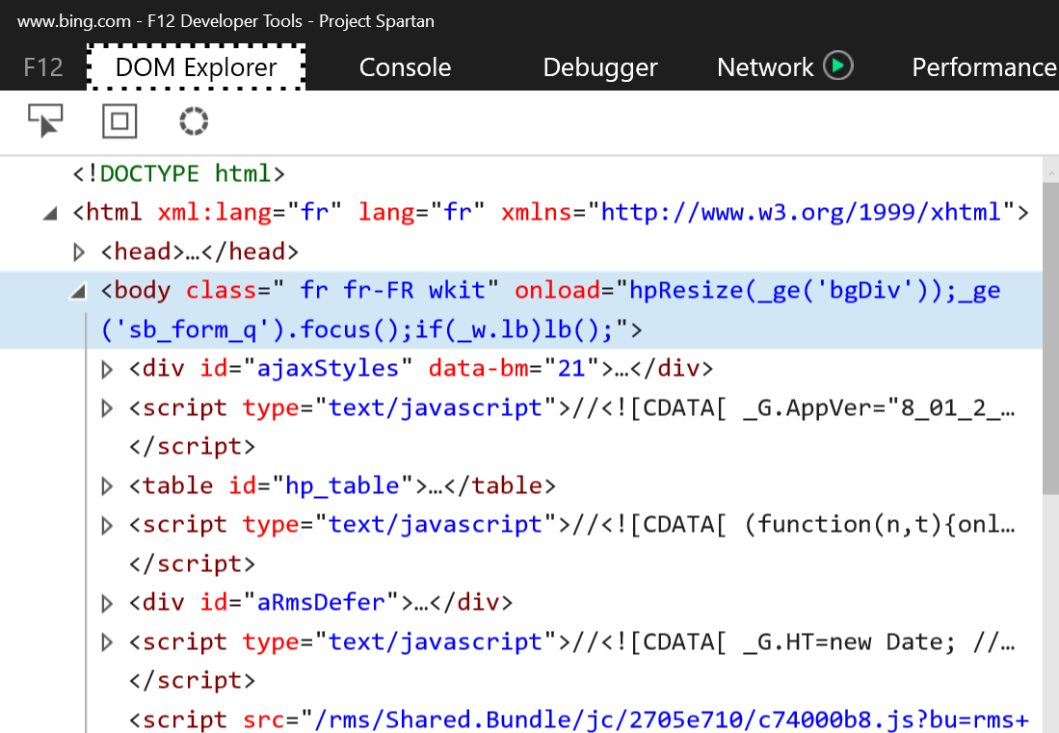
Debugging on the web
Perfect on desktop using F12 tools
Less easier on mobile
Proprietary tools
Chrome to Chrome, Safari to Safari, etc.
Requires USB connection
WeinRE :
not extensible
requires chrome
not cross-platform
not so pretty ;-)

Slide 3
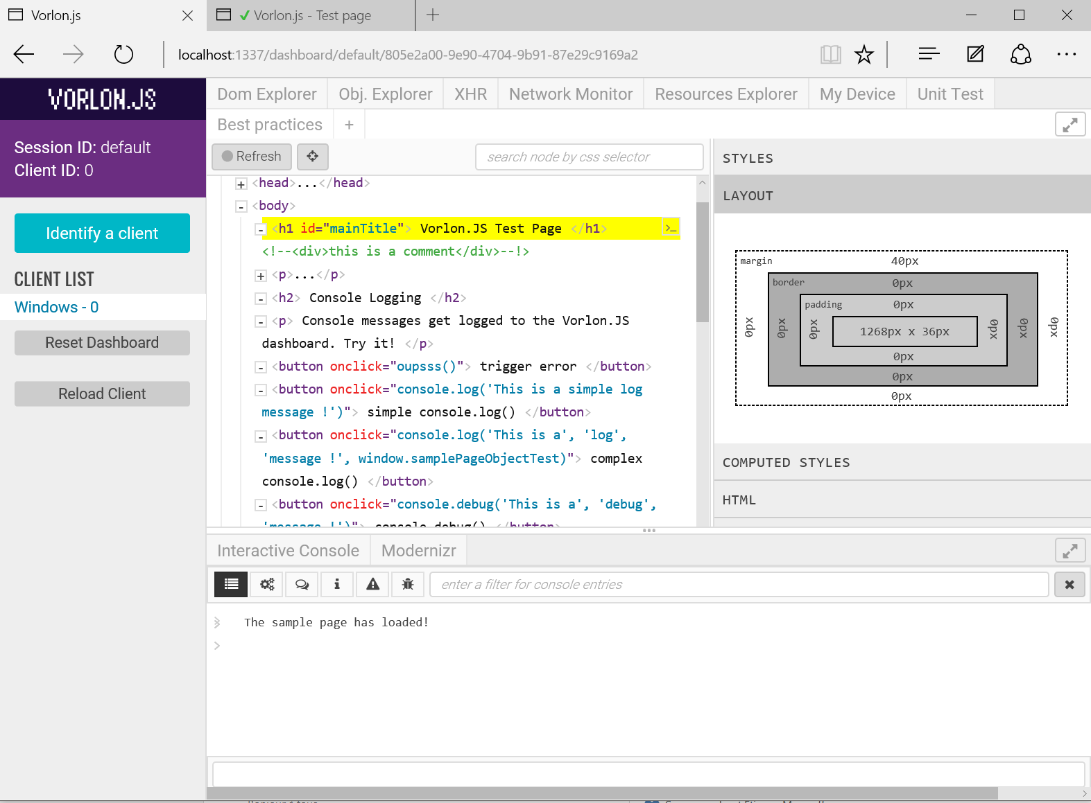
Vorlon.js – http://vorlonjs.io
Vorlon.js is :
A web remote debugging tool
Cross-browser, cross-platform
Open-source
Based on :
Node.js
Passport.js
Socket.io
Express.js

Slide 4
How to install Vorlon.js server ? (1/2)
From npm using the command prompt :
By cloning the github repo :
npm install –g vorlon
vorlon
git clone https://github.com/Microsoftdx/vorlonjs
cd vorlonjs
npm install
npm start

Slide 5
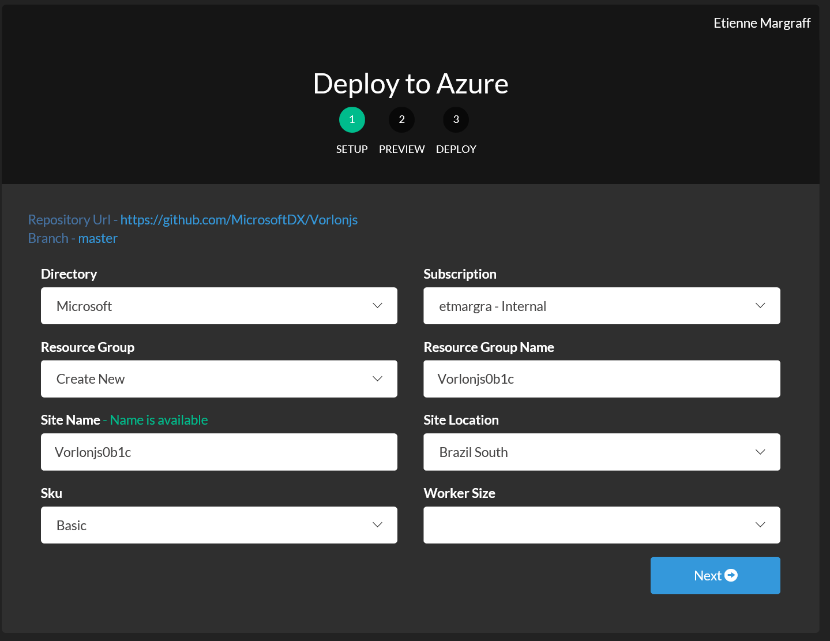
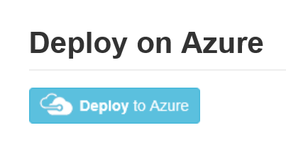
How to install Vorlon.js server ? (1/2)
Using the deploy to Azure button from GitHub
https://github.com/MicrosoftDX/Vorlonjs/blob/master/README.md

Slide 6
Connect your client website
Modify the website code and add a script reference to a vorlon.js file generated by the server you installed
<script src="http://localhost:1337/vorlon.js"></script>

Slide 7
10 plugins by default
Interactive console
DOM Explorer
Modernizr
XHR Panel
Object Explorer
Network Monitor
Resource Explorer
ngInspector
Unit tests
Best practices

Slide 8
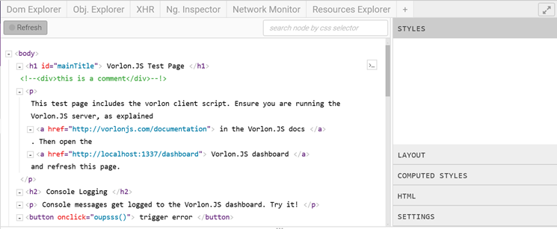
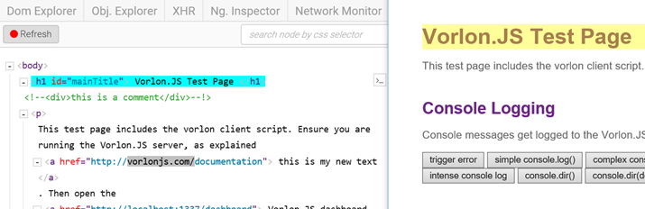
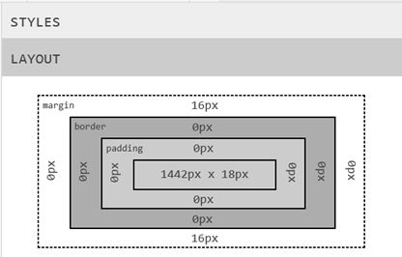
DOM Explorer
Let you browse the DOM on your client
CSS, DOM attributes and properties live edit
Refresh button
Layout, Computed Styles, HTML DOM Edit
Highlight on client when overring with the mouse in DOM explorer

Slide 9
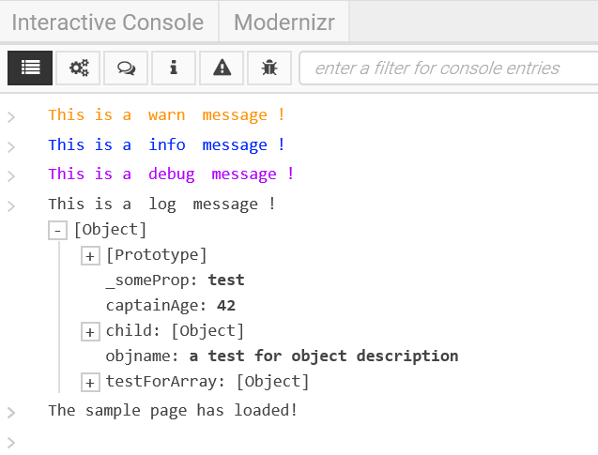
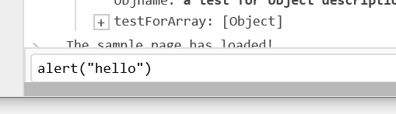
Interactive Console
Displays all the logs from the client
Sortable, filterable, searchable
You can execute JavaScript code on the client from the immediate window

Slide 10
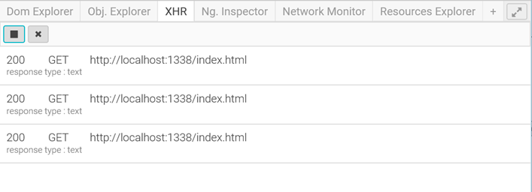
XHR Panel
helps you get the list of requests done through XMLHttpRequest.
You can choose to enable or disable the recording using the play button

Slide 11
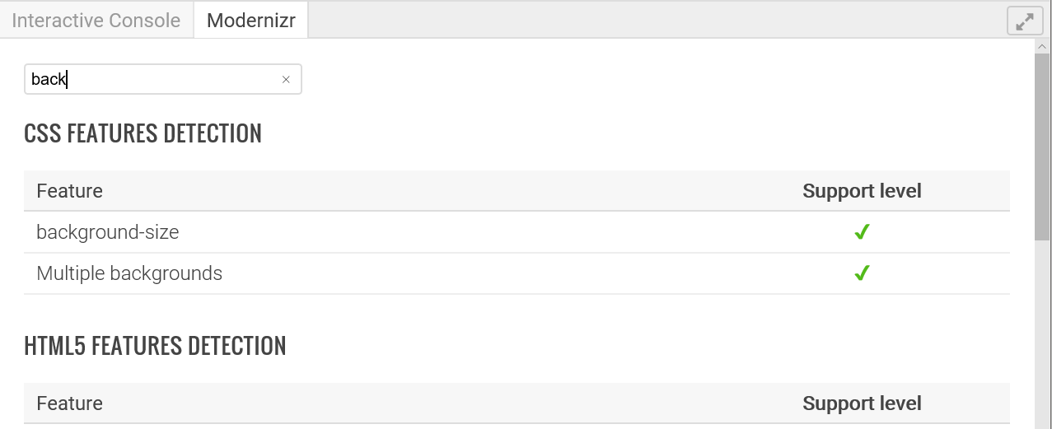
ModernizR
Displays a list of web features
Tells you which one is available on the browser you are testing

Slide 12
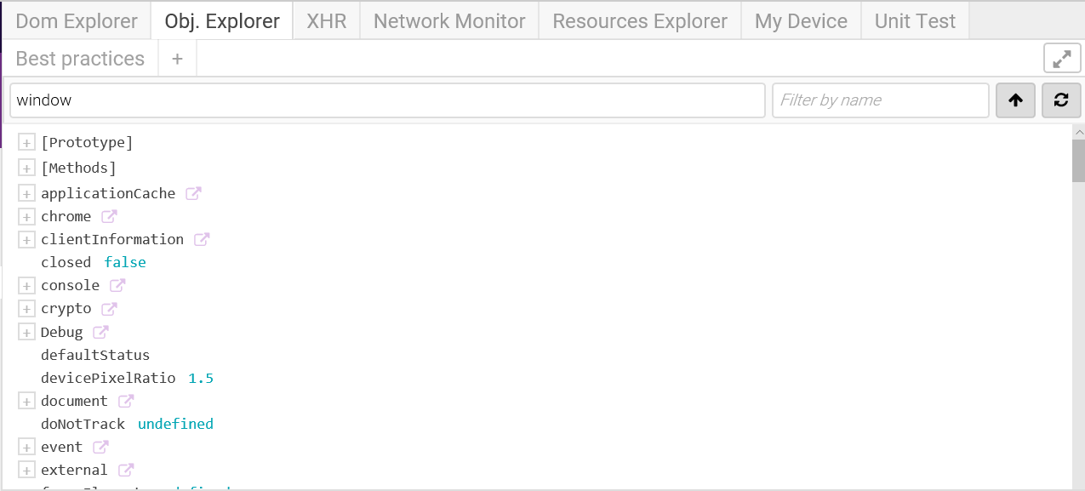
Object Explorer
Hierachical list of all the javascript objects available in window
Filterable
Searchable

Slide 13
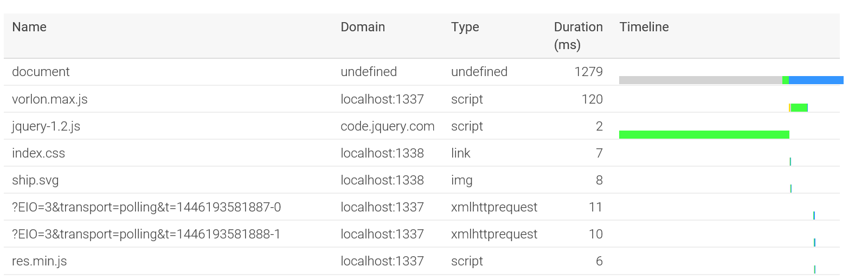
Network Monitor
see all the network exchanges that are done between the browser and the web server.
Provides the resource name, the server domain, the type of request, the duration in milliseconds
Visual waterfall

Slide 14
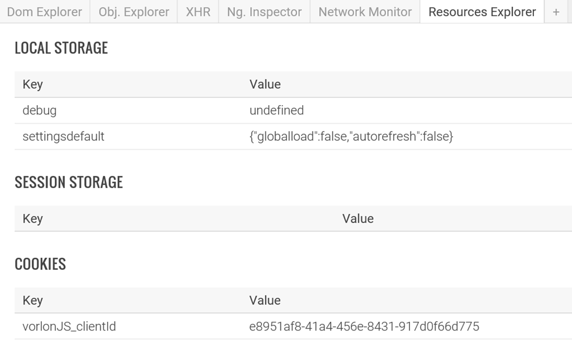
Resource Explorer
What is stored locally on the client browser instance.
Data about :
Sessions
Cookies
Local Storage

Slide 15
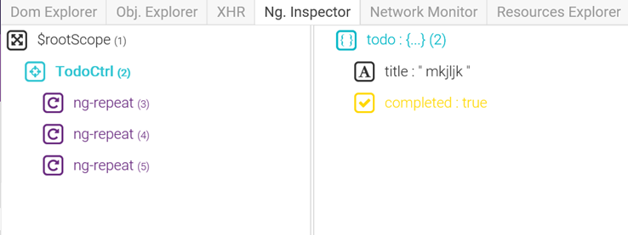
NGInspector
$scope debugger for Angular.js.
Access to all the values stored in each scope
This first version gives you information
Edit might come later

Slide 16
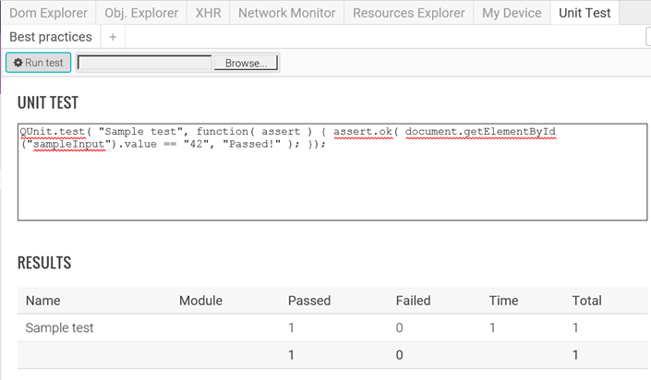
Unit Tests - qUnit
Run unit test on the client from the dashboard
Type your test in the box
Browse and load a qunit test file
Results are displayed as a summary

Slide 17

Enable / Disable plugins
Config.json file on the Server Folder
Change the « enabled » parameter from true to false on plugins
You can enable and disable more things here like authentication

Slide 18
How to create your own plugin ?
Tutorial available here :
http://bit.ly/vorlonplugin

Slide 19
Using Vorlon.js to improve web sites compatibility with web standards
Part II

Slide 20
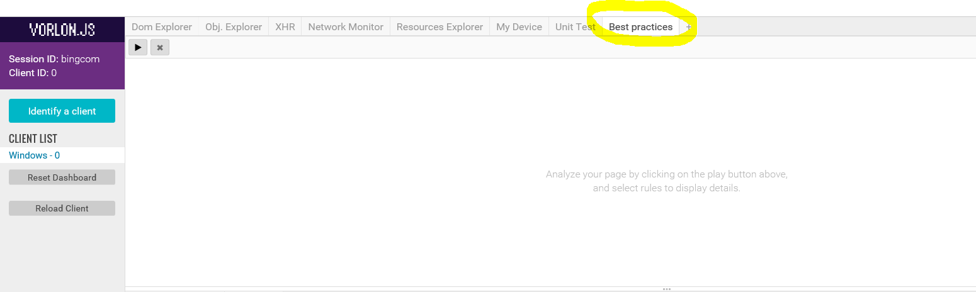
Best practices plugin

Slide 21
Best practices plugin
Dynamic analysis
More precise results than https://dev.modern.ie/tools/staticscan
Not based on text analysis
Can be extended
Slower than static analysis

Slide 22
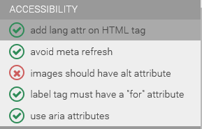
Accessibility
Check for accessibility best practices
lang attribute
No meta refresh
alt attribute
for attribute
ARIA support

Slide 23
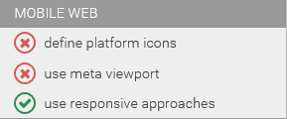
Mobile WEB
Platform icons helps user pinning your website with an icon that fits well on mobile device home
Use meta viewport tag to choose how your website will get scaled on smaller devices like phones
Be responsive

Slide 24
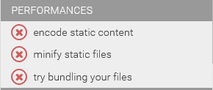
Performances
Content encoding like gzip or deflate helps reducing the network bandwidth required to display your website
Minification helps reducing the network bandwidth required to display your website
Multiple http requests makes your site slower

Slide 25
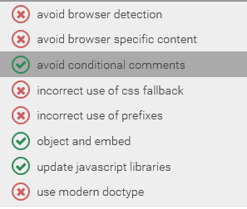
Web standards
This portion of the plugin focus on web standards and will dynamically check how features are used and detected
Hands on labs:
https://github.com/deltakosh/interoperable-web-development

Slide 26
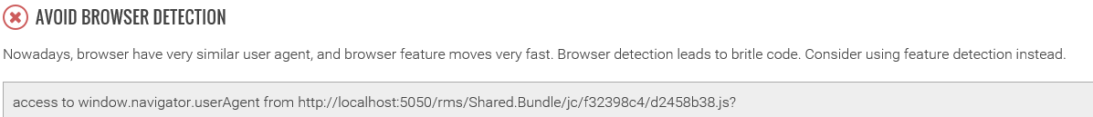
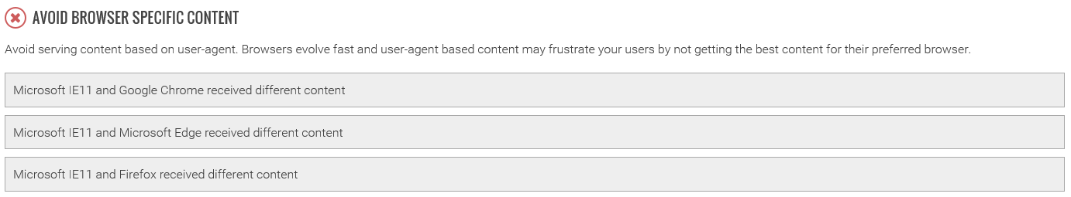
Dynamic analysis
Dynamic analysis can provide more insightful details:

Slide 27
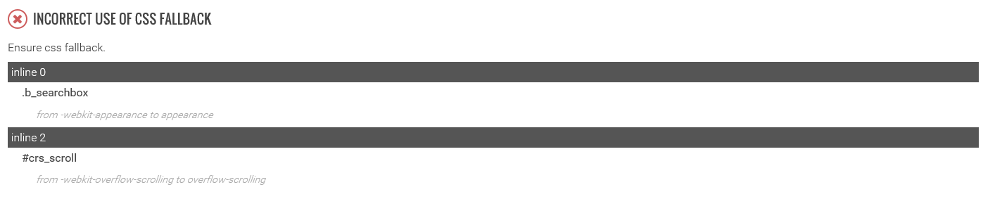
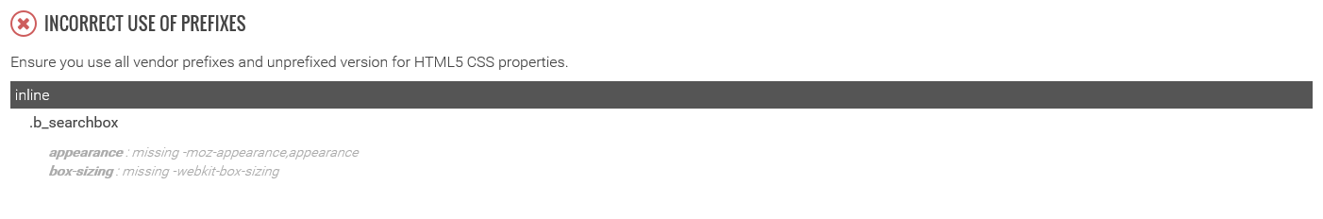
Dynamic analysis
Dynamic analysis can provide more insightful details:

Slide 28
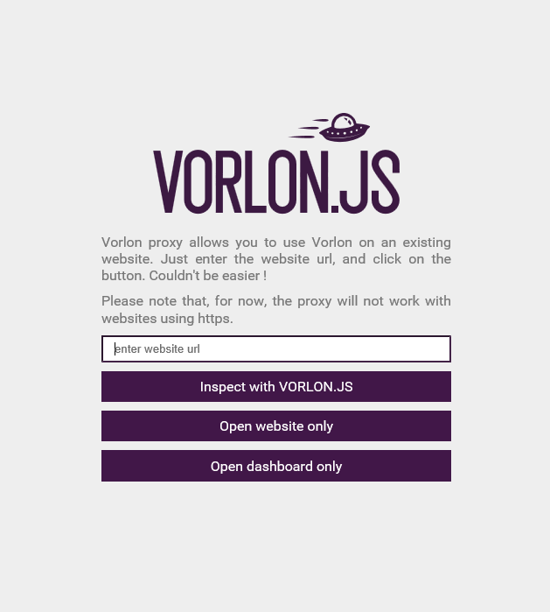
Using Vorlon.js proxy
Inject Vorlon.js afterwards
Based on a proxy so some sites may not work
You can do a web site analysis in a minute

